Slide 1


Connecting to SQL Server

Slide 2
Connecting to SQL
Click Database
Click Driver Manager
Click New
Put the following settings:
Driver Type: Generic
Driver Name: SQL Server
Class Name: com.microsoft.sqlserver.jdbc.SQLServerDriver
URL Template: jdbc:sqlserver://{host}[:{port}][;databaseName={database}]
Default Port: 1433
Default Database: master
Move to the Libraries tab

Slide 3
Connecting to SQL
On the Libraries Tab
Click Add File
Navigate to C:/Program Files/Dbeaver/plugins
Open mssql-jdbc-12.4.1.jre11.jar
Click Add File again
Navigate to C:/Program Files/Dbeaver/jre/bin
Change the file type selector to *.*
Open mssql-jdbc_auth-12.4.1.x64.dll
Click Ok
Click Database
Click New Database Connection

Slide 4
Connecting to SQL
Select your Generic SQL Server from the All tab
Enter the following properties
Host: DEVSQL17\CountyStat_DW
Port: 50900
Database/Schema: HealthCare_DataWarehouse
Username: Your T#
Password: Your Windows Password
Click Ok
Double Click the new connection from the Database Navigator
The connection should fail
Right click the Connection and select Edit Connection

Slide 5
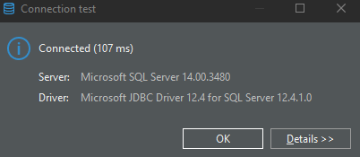
Connecting to SQL
Navigate to the Driver properties Tab
Verify the encrypt property is set to true
Set the integratedSecurity property to true
Set the trustServerCertificate property to true
Click Test Connection
If you get this screen click OK
If not raise your hand

